Slide 1
INVARIANCE PROPERTIES OF AN ESTIMATOR
Submited by
Vismaya k k
Reg No:GAAVMST011

Slide 2
OBJECTIVES
To check which properties of an estimator like Consistency,Sufficiency,Unbiasedness and Efficiency satisfies invariance property.
To check whether CAN satisfy invariance property.
To check which methods of estimator such as Method of Moment and Maximum Likelihood Estimator satisfy Invariance property.

Slide 3
Estimation: It is the process to estimate unknown value of population parameter with the help of sample
It was developed by R A Fisher in 1930
These are two types
Point estimation : A single number used to estimate a population parameter with the help of a sample is called a point estimate . The process of estimating a single number is known as point estimaion
Interval estimation: A range of values used to estimate a population parameter with the help of a sample is called an interval estimate , and the process of estimating with a range of values is known as interval estimation

Slide 4
Properties of a good estimator
Consistency : Consistency is a large sample property of estimator Let x1, x2...xn be a random sample from a population indexed by a parameter θϵΩ. T hen the sequence of estimator tn(x1, x2, ...xn)=tn(say) a consistent estimator of θ if
tn → θ as n → ∞ ,In other words
P{| tn − θ | ≤ ε} → 1 or P{| tn − θ | > ε} → 0 as n → ∞
Sufficiency : Let tn = t(x1, x2, ...xn) is an estimator for a parameter θ based on random sample x1, x2, ...xn . Then the conditional distribution of x1, x2, ...xn given t is independent of θ . Then t is Sufficient Estimator of θ

Slide 5
Unbiasedness :Let X be random variable having probability distribution indexed by an unknown parameter θ. An estimator t = t(x1, x2, ...xn) is an unbiased estimator of the parameter θ if E(t) = θ , ∀ θϵΩ
Efficiency: Let T1 and T2 are two estimators of a parameter θ based on the random sample x1, x2, ...xn . Then if V (T1) < V (T2) then T1 is more efficient than T2 and the efficiency of T1 with respect to T2 is
Relative Eff iciency =(1/V (T1))/(1/V (T2))
=(V (T2))/(V (T1))

Slide 6
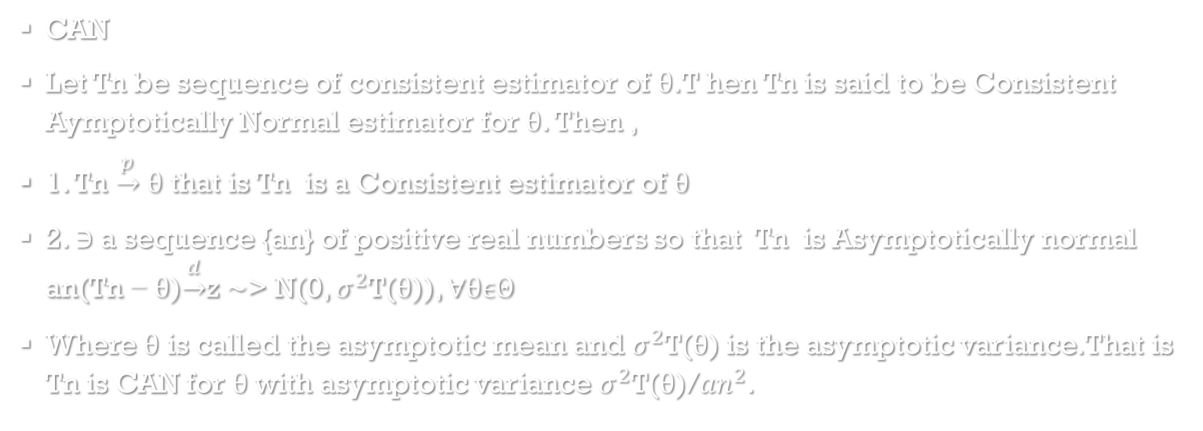
CAN
Let Tn be sequence of consistent estimator of θ.T hen Tn is said to be Consistent Aymptotically Normal estimator for θ. Then ,
1. Tn $\underset{→}{p}$ θ that is Tn is a Consistent estimator of θ
2. ∋ a sequence {an} of positive real numbers so that Tn is Asymptotically normal an(Tn − θ)$\underset{→}{d}$z ∼> N(0, $σ^{2}$T(θ)), ∀θϵΘ
Where θ is called the asymptotic mean and $σ^{2}$T(θ) is the asymptotic variance.That is Tn is CAN for θ with asymptotic variance $σ^{2}$T(θ)/${an}^{2}$.

Slide 7
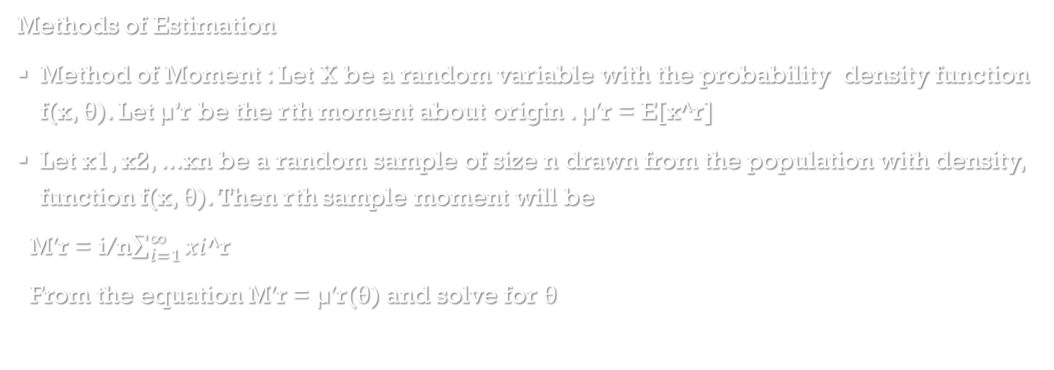
Methods of Estimation
Method of Moment : Let X be a random variable with the probability density function f(x, θ). Let µ’r be the rth moment about origin . µ′r = E[x^r]
Let x1, x2, ...xn be a random sample of size n drawn from the population with density, function f(x, θ). Then rth sample moment will be
M′r = i/n$\sum_{i=1}^{∞}{xi}$^r
From the equation M′r = µ′r(θ) and solve for θ

Slide 8
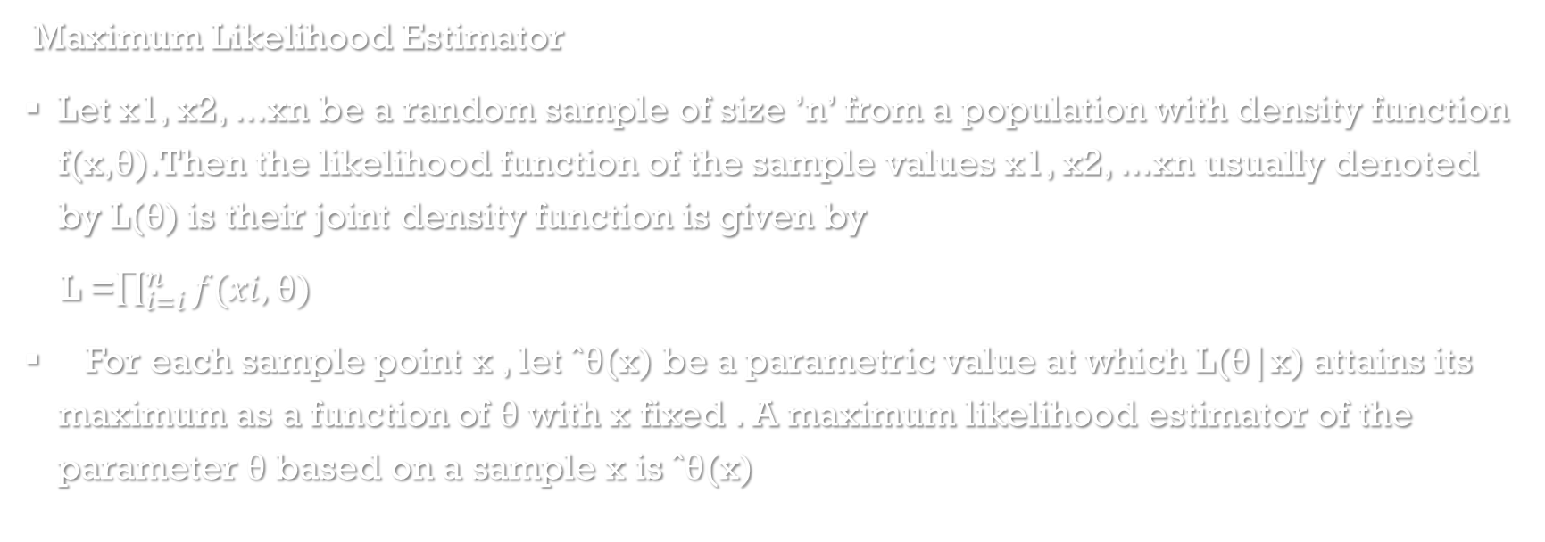
Maximum Likelihood Estimator
Let x1, x2, ...xn be a random sample of size ’n’ from a population with density function f(x,θ).Then the likelihood function of the sample values x1, x2, ...xn usually denoted by L(θ) is their joint density function is given by
L =$\prod_{i=i}^{n}{f(xi,θ)}$
For each sample point x , let ˆθ(x) be a parametric value at which L(θ|x) attains its maximum as a function of θ with x fixed . A maximum likelihood estimator of the parameter θ based on a sample x is ˆθ(x)

Slide 9
What is invariance property?
In mathematics an invariant is a property of a mathematical object(or a class of mathematical objects which remains unchanged after operations or transformation of a certain type are applied to the objects
Strictly speaking , ”invariant” would mean that the estimates themselves are unchanged when both the measurement and the parameters are transformed in a compatible way
The concept of invariance is sometimes used on its own as a way of choosing between estimators , but this is not necessarily definitive.

Slide 10
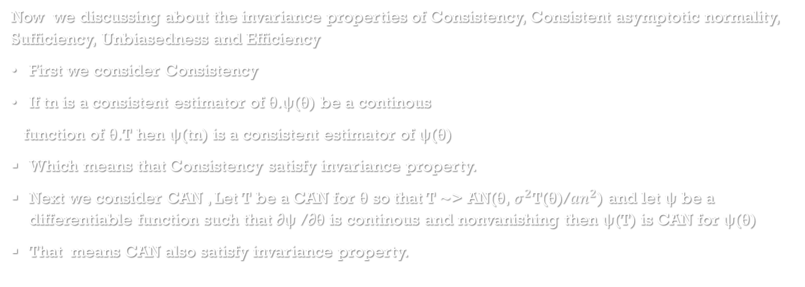
Now we discussing about the invariance properties of Consistency, Consistent asymptotic normality, Sufficiency, Unbiasedness and Efficiency
First we consider Consistency
If tn is a consistent estimator of θ.ψ(θ) be a continous
function of θ.T hen ψ(tn) is a consistent estimator of ψ(θ)
Which means that Consistency satisfy invariance property.
Next we consider CAN , Let T be a CAN for θ so that T ∼> AN(θ, $σ^{2}$T(θ)/${an}^{2}$) and let ψ be a differentiable function such that ∂ψ /∂θ is continous and nonvanishing then ψ(T) is CAN for ψ(θ)
That means CAN also satisfy invariance property.

Slide 11
Next Sufficiency , in the case of sufficiency if t is Sufficient estimator of θ and t(u) is one-to-one function of t then t(u) is sufficient estimator of t(θ).
Next one is Unbiasedness.
If T is an unbiased estimator for a parameter θ , then g(T) does not have to be an unbiased estimator for g(θ) However , there is one special case in which unbiasedness does carry over.
That is in the case of linear function it satisfy invariance property.
Finally in this section we consider Efficiency
The efficiency of an estimator destroyed by a Nonlinear transformation.But efficiency is maintained for linear transformation.

Slide 12
Next invariance properties of method of estimation
First one is Method of moment.
Here we check method of moment of a linear function.
In the case of linear function it satisfy invariance property.
Next MLE τ (ˆθ) is the ML Estimator for θ and τ is a single valued and twice differentiable function of θ then,
τ (ˆθ) is the ML Estimator for τ (θ).
MLE also satisfy invariance property.

Slide 13
Thank you

